Slide 1
Instructions Formats

Slide 2
Outline
IAS Instruction set
Instruction Set:
      Characteristics and Functions

Slide 3
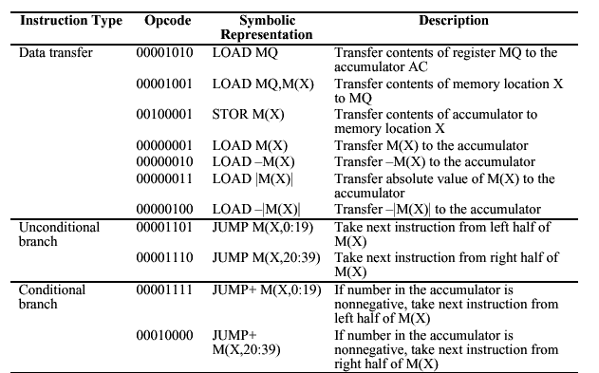
IAS Instruction set

Slide 4
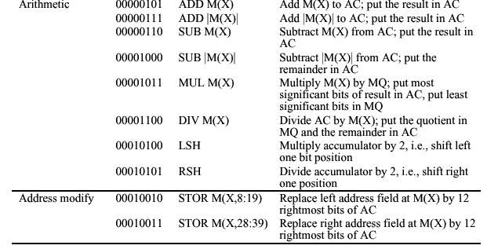
IAS Instruction set (continued)

Slide 5
Problem
Write an appropriate assembly language code for the following operation and interpret to Von Neumann IAS architecture
X=Y*Z
// Where X->40 bit data and Y->40 bit data
Result would be more than 40 bit.

Slide 6
Assume that data variables ‘Y’ & ‘Z’ available at memory locations 801 & 802 resly. And X will be stored 803 onwards.
LOAD MQ, M(801) MQ←M[801]
MUL M(802) Ac←MQ * M[802]
STOR M(803) M[803]←AC
LOAD MQ AC←MQ
STOR M(804) M[804]←AC

Slide 7
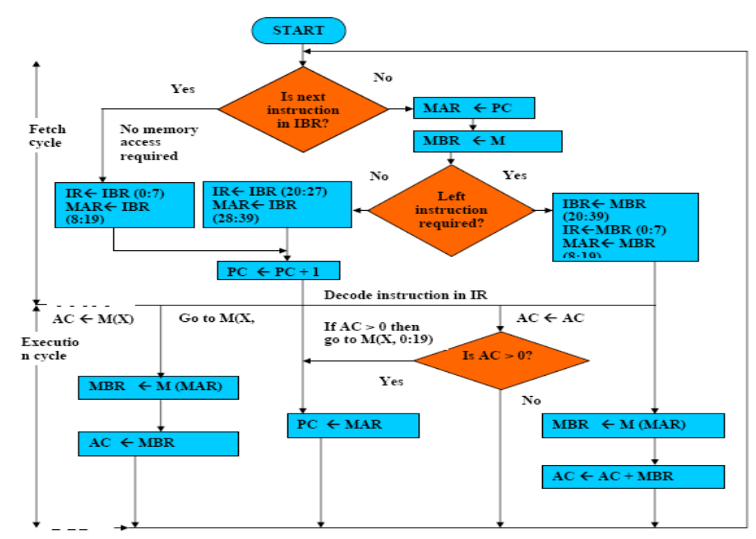
Fetch / Execute Cycle
V.Saritha, SCSE, VIT University
p.c@saritha.v

Slide 8


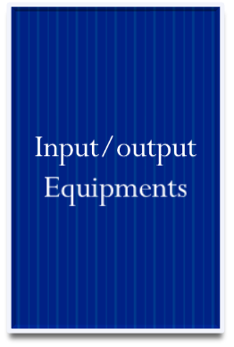













IAS Computer
MAR←PC
MBR←M[MAR]
IBR←MBR<20..39>
IBR←MBR<20..39>
IR←MBR<0..7>
IR←MBR<0..7>
MAR←MBR<8..19>
MAR←MBR<8..19>
MBR←M[MAR]
MBR←AC
AC←MBR
M[MAR}←MBR
IR←IBR<0..7>
IR←IBR<0..7>
MAR←IBR<8..19>
MBR←M[MAR]
AC←AC + MBR
PC←PC+1
MAR←PC
MBR←M[MAR]
p.c@saritha.v

Slide 9

AC = 7
AC = 3
MEMORY
1. LOAD M(X) 500, ADD M(X) 501
2. STOR M(X) 500, (Other Ins)
.....
3
4
AC
MQ
500
MBR = 4
LOAD M(X)
MBR
MBR = 3
500
ADD M(X) 501
(Other Ins)
STOR M(X)
PC
1
2
MAR
1
500
501
2
500
MBR
LOAD M(X) 500, ADD M(X) 501
3
4
STOR M(X) 500, (Other Ins)
IR
LOAD M(X)
ADD M(X)
STOR M(X)
IBR
ADD M(X) 501
(Other Ins)
AC
3
501
PC = 2
7
IBR
PC = 1
Add M(X)
Mar ← PC
MAR ←PC
3
LOAD M(X) 500, ADD M(X) 501
4
IR
MAR = 2
STOR M(X) 500, (Other Ins)
MAR = 501
MAR = 1
MAR = 500
MAR =500
add = 501
add = 1
add = 500
add = 2

Slide 10
AC = 7
AC = 3
MEMORY
1. LOAD M(X) 500, ADD M(X) 501
2. STOR M(X) 500, (Other Ins)
.....
3
4
AC
MQ
500
MBR = 4
LOAD M(X)
MBR
MBR = 3
500
ADD M(X) 501
(Other Ins)
STOR M(X)
PC
1
2
MAR
1
500
501
2
500
MBR
LOAD M(X) 500, ADD M(X) 501
3
4
STOR M(X) 500, (Other Ins)
IR
LOAD M(X)
ADD M(X)
STOR M(X)
IBR
ADD M(X) 501
(Other Ins)
AC
3
501
PC = 2
7
IBR
PC = 1
Add M(X)
Mar ← PC
MAR ←PC
3
LOAD M(X) 500, ADD M(X) 501
4
IR
MAR = 2
STOR M(X) 500, (Other Ins)
MAR = 501
MAR = 1
MAR = 500
MAR =500
add = 501
add = 1
add = 500
add = 2
p.c@saritha.v

Slide 11
Example Problems
Write an Assembly language programming for the following expressions using IAS computer Instruction set and interpret to the flow of IAS computer
  1. A=(B-C)*D
  2. A=B*(C+D)
Make necessary assumptions.

Slide 12
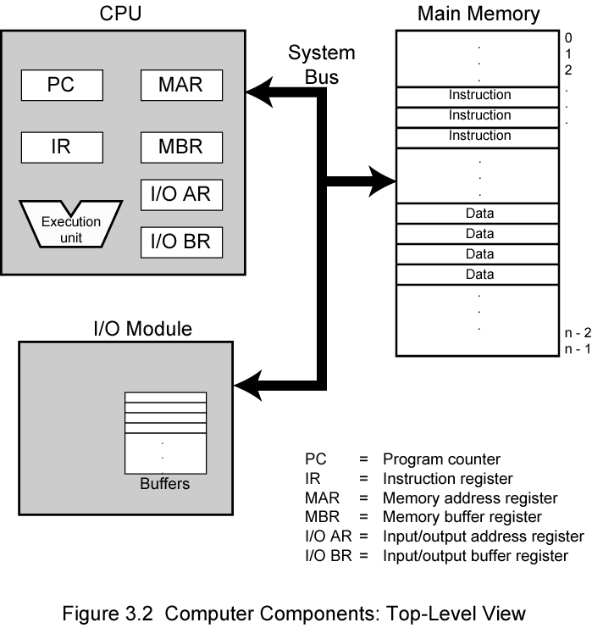
Computer Components:
Top Level View

Slide 13

Instruction Cycle
The IAS operates repetitively performing an instruction cycle.
Each instruction cycle consists of Two subcycles.
Two steps:
  Fetch
  Execute

Slide 14
Fetch Cycle
Program Counter (PC) holds address of next instruction to fetch
Processor fetches instruction from memory location pointed to by PC
Increment PC
  Unless told otherwise
Instruction loaded into Instruction Register (IR)
Processor interprets instruction and performs required actions

Slide 15
Execute Cycle
Processor-memory
  data transfer between CPU and main memory
Processor- I/O
  Data transfer between CPU and I/O module
Data processing
  Some arithmetic or logical operation on data
Control
  Alteration of sequence of operations
  e.g. jump
Combination of above

Slide 16
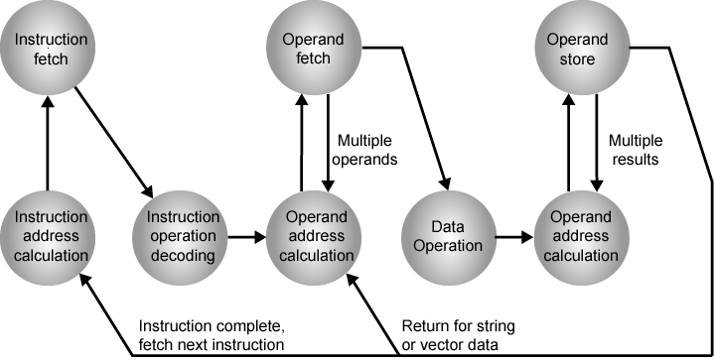
Instruction Cycle State Diagram

Slide 17
Instruction state cycle diagram (cont..)
Instruction address calculation (iac):
  Determine the address of the next instruction to be executed. Adding a fixed number to a next number.
Instruction fetch: (if)
  Read the instruction from its memory location into the processor.
Instruction operation decoding (iod)
  Analyze instruction to determine type of operation to be performed and operand(s) to be used.
Operand Address Calculation: (oac)
  If the operation involves the reference to an operand in memory or available via I/O, then determine the address of the operand.
Operand Fetch (of):
  Fetch the operand from memory or read it from I/O.
Data Operation (do):
  Perform the operation indicated in the instruction.
Operand store (os)
  Write the result into memory or out to I/O.

Slide 18
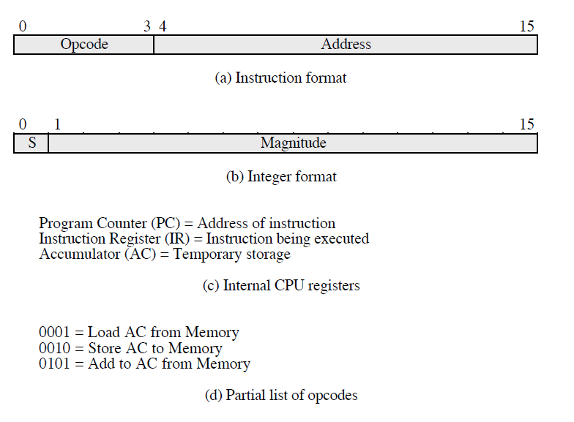
Characteristics of Hypothetical Machine

Slide 19
Characteristics of Hypothetical Machine (cont..)
The processor contains a single data register called an accumulator (AC). Both instructions and data are 16 bits long. Thus it is convenient to organize memory using 16 bit words.
The instruction format provides 4 bits for the opcode, so that there can be as many as 2⁴ =16 different opcodes, and upto 2¹²= 4096(4K) words of memory can be directly addressed.

Slide 20
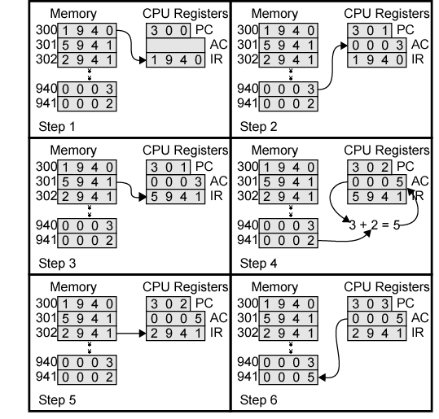
Example of Program Execution

Slide 21
Instruction
Definition:
  Instruction is a statement by which the operation of CPU is determined.
  These instructions referred as “Machine instructions or computer Instructions”
  The collection of different instructions that the CPU can execute is referred to as the CPU’s instruction set.

Slide 22
What must an instruction set specify…?

Slide 23
Which Operation to perform
Where to find the operand or operands
Where to put the result, if there is result
Where to find the next instruction

Slide 24
Instruction Representations
Each instruction is represented by sequence of bits
The instruction is divided into two fields
  Opcode field
  Operand field
This operand field further divided into one to four fields.
This layout of the instruction is known as the “Instruction Format”
Simple instruction format
Opcode
Operand
Address1
Operand
Address2
Result
Address1
Next
Instruction

Slide 25
Instruction Set category
Instruction Set is categorized into types based on
  Operation performed
  number of operand addresses
  and addressing modes.

Slide 26
Based on number of operand address in the instruction.
    4 Address Instruction
    3 Address Instruction
    2 Address Instruction
    1 Address Instruction
    0 Address Instruction

Slide 27

How to Evaluate the Arithmetic statement in ZERO,ONE,TWO,THREE Address
SYMBOLS- ADD,SUB,MUL,DIV for arithmetic operations
MOVE –for Transfer type Operation
LOAD and STORE for transfers to and from Memory and AC registers

Slide 28
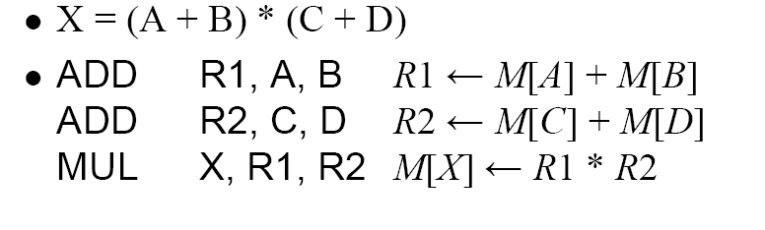
Three Address Instruction
Each address field to Specify either a
Processor Register or Memory Operand
Eg: Cyber 170

Slide 29
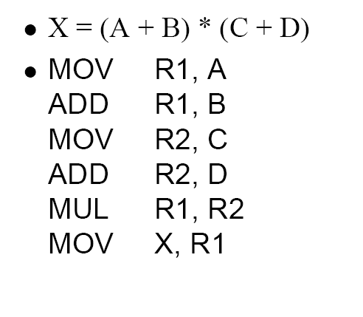
Two Address Instruction
Move Instruction
Moves or transfers
the operands to
and from memory
And processor
Registers

Slide 30
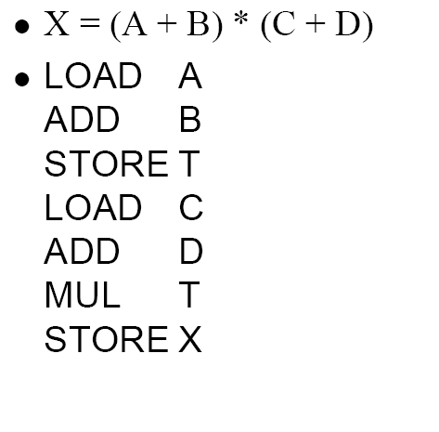
One Address Instruction
USES AC
Accumulator reg
AC <- M[A]
AC <- AC+ M[B]
M[T]<- AC
AC <- M [C]
AC<- AC+ M[D]
AC <- AC * M[T]
M[X]<- AC
T -Temporary Location

Slide 31
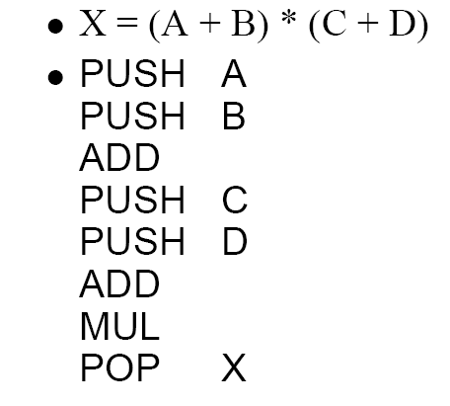
Zero Address Instruction
Do not use
Address Field for
Instruction
TOS<- A
TOS <-B
TOS<- A+B
TOS<- C
TOS<-D
TOS<-C+D
TOS<-(C+D)* (A+B)
M[X]<- TOS

Slide 32
Calculation of Memory traffic
Assumptions
  24-bit memory address (3 bytes)
  128 instructions (7 bits rounded to 1 byte)

Slide 33





4- Address Instruction
Memory
24 Bits / 3 Bytes
8
24
24
24
24
Op Code
ResAddr
Op1Addr
Op2Addr
NextiAddr
Op Code
ResAddr
Op1Addr
Op2Addr
NextiAddr
CPU
Op1
Example: add M1,M2,M3, nexti
M(1)←M(2)+M(3)
Op2
+
Resop
Memory Required to Encode an Instruction:
1Byte+ 4 x 3 bytes = 13 Bytes
Calculation of Memory Accesses
To fetch Instruction itself
To Execute an Instruction
Opcode=1
Op1Addr=1
Op1=1
Op2Addr=1
Op2=1
ResAddr=1
Res=1
NextiAddr=1
Total=3
Total=5
Total Memory Traffic= No. of M/A to fetch + No. of M/A to Execute
Total Memory Traffic= 5 + 3 =8

Slide 34
4 –address Instruction
Because of the large instruction word size and number of memory accesses ,the 4- address machine and instruction format is not seen in the machine design.
Although the 4-address structure is used internally in some implementations of computer control units. This kind of controller implementations is known as micro
coded Control.

Slide 35
3- Address Instruction
Memory
24 Bits / 3 Bytes
8
24
24
24
Op Code
ResAddr
Op1Addr
Op2Addr
Op Code
ResAddr
Op1Addr
Op2Addr
CPU
Op1
Example: add M1,M2,M3
M(1)←M(2)+M(3)
Op2
+
Resop
Memory Required to Encode an Instruction:
1Byte+ 3 x 3 bytes = 10 Bytes
PC
24
Calculation of Memory Accesses
To fetch Instruction itself
To Execute an Instruction
Opcode=1
Op1Addr=1
Op1=1
Op2Addr=1
Op2=1
ResAddr=1
Res=1
Total=4
Total=3
Total Memory Traffic= No. of M/A to fetch + No. of M/A to Execute
Total Memory Traffic= 4+ 3 =7

Slide 36
3-Address instruction:
  Address of next instruction kept in processor state register—the PC (Except for explicit Branches/Jumps)
  Rest of addresses in instruction
  This Instruction will require 3X3+1= 10 bytes to encode a 3-address ALU instruction.
  The number of memory access are required for a 3-address instruction:
  Four words will be transferred to the CPU when the instruction itself is fetched.= 4
  Then the two words representing the operands themselves need to be fetched into the CPU = 2
  And after the addition has been performed, the result needs to be written back to memory = 1
Total =07

Slide 37
2- Address Instruction
Memory
24 Bits / 3 Bytes
8
24
24
Op Code
Op1Addr
Op2Addr
CPU
Op Code
Op1Addr
Op2Addr
Example: add M2,M3
M(2)←M(2)+M(3)
Op1
Op2
+
Memory Required to store an Instruction:
3 x 3 bytes = 09 Bytes
Resop
Memory Required to Encode an Instruction:
1Byte+ 2 x 3 bytes = 7 Bytes
PC
24
Calculation of Memory Accesses
To fetch Instruction itself
To Execute an Instruction
Opcode=1
Op1Addr=1
Op1=1
Op2Addr=1
Op2=1
Res=1
Total=3
Total=3
Total Memory Traffic= No. of M/A to fetch + No. of M/A to Execute
Total Memory Traffic= 3+ 3 =6

Slide 38
2-address Instruction :
  Result overwrites Operand 2
  Needs only 2 addresses in instruction but less choice in placing data
  This Instruction will require 2X3+1= 7 bytes to encode a 2-address ALU instruction.
  The number of memory access are required for a 2-address instruction:
  Three words will be transferred to the CPU when the instruction itself
is fetched. = 3
  Then the two words representing the operands themselves need to be fetched into he CPU and after the addition has been performed, Result overwrites Operand =3
  Total= 06
  add Op1Addr Op2Addr

Slide 39
1- Address Instruction
Memory
24 Bits / 3 Bytes
8
24
Op Code
Op1Addr
CPU
Op Code
Op1Addr
Op1
Example: add M2
Op2
+
Resop
Memory Required to Encode an Instruction:
1Byte+ 1 x 3 bytes = 4Bytes
Acc
PC
24
Calculation of Memory Accesses
To fetch Instruction itself
To Execute an Instruction
Opcode=1
Op1Addr=1
Op1=1
Total=2
Total=1
Total Memory Traffic= No. of M/A to fetch + No. of M/A to Execute
Total Memory Traffic= 2+ 1 =3

Slide 40
1-address Instruction :
  Special CPU register, the accumulator, supplies 1 operand and stores result
  One memory address used for other operand
  Need instructions to load and store operands:
    LDA OpAddr
    STA OpAddr
This Instruction will require 1X3+1= 4 bytes to encode a 1-address ALU instruction
The number of memory access are required for a 1-address instruction:
  Two words will be transferred to the CPU when the instruction itself is fetched = 2
  Then the one word representing the operand itself need to be fetched into
the CPU register and the accumulator, supplies 1 operand and stores
result = 1
  Total=03

Slide 41
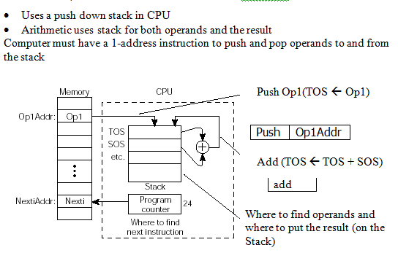
0-Address Instruction

Slide 42
Comparisons
Instruction Type | Memory To Store in Bytes | Memory To Encode in Bytes | M/As to fetch an Instruction | M/As to Execute an Instruction | Memory Traffic
4-address | 5 x 3 = 15 | 1+(4 x 3) = 13 | 5 | 3 | 5+3=8
3-Address | 4 x 3 = 12 | 1+(3 x 3) = 10 | 4 | 3 | 4+3=7
2-Address | 3 x 3 = 09 | 1+(2 x 3) = 07 | 3 | 3 | 3+3=6
1-Address | 2 x 3 = 06 | 1+(1 x 3) = 04 | 2 | 1 | 2+1=3
0-Address | 1 x 3 = 03 | 1+(0 x 3) = 01 | 1 | 0 | 1+0=1

Slide 43
Problems
Evaluate a = (b+c)*d – e in 3-, 2-, 1-, 0- address machines and compute the memory traffic. Assume 24 bit memory address and one byte opcode.
3-address | 2-address | 1-address | 0-address
add a,b,c mul a,a,d sub a,a,e | load a,b Add a,c Mul a,d Sub a,e | Load b Add c Mul d Sub e Store a | Push b Push c Add Push d Mul Push e Sub Pop a
Memory traffic for 3-address
Machine: 7 * 3 = 21
Memory traffic for 2-address
Machine: 6 * 4 = 24
Memory traffic for 1-address
Machine: 3 * 5 = 15
Memory traffic for 0-address
Machine: 3 * 5 + 3 = 18

Slide 44
Memory to Store | Memory to encode | M/As to Fetch | M/As to Execute | Memory Traffic
4*3=12 | 1+(3*3)=10 | 4 | 3 | 4+3=7
4*3=12 | 1+(3*3)=10 | 4 | 3 | 4+3=7
4*3=12 | 1+(3*3)=10 | 4 | 3 | 4+3=7
36 | 30 | 12 | 9 | 21
add a, b, c
a←b+c
mpy a, a, d
a←a*d
sub a, a, e
a←a-e
Memory to Store | Memory to encode | M/As to Fetch | M/As to Execute | Memory Traffic
3*3=9 | 1+(2*3)=7 | 3 | 2 | 3+2=5
3*3=9 | 1+(2*3)=7 | 3 | 3 | 3+3=6
3*3=9 | 1+(2*3)=7 | 3 | 3 | 3+3=6
3*3=9 | 1+(2*3)=7 | 3 | 3 | 3+3=6
36 | 28 | 12 | 11 | 23
load a, b
a←b
add a, c
a←a+c
mpy a, d
a←a*d
sub a, e
a←a-e

Slide 45
Memory to Store | Memory to encode | M/As to Fetch | M/As to Execute | Memory Traffic
2*3=6 | 1+(1*3)=4 | 2 | 1 | 2+1=3
2*3=6 | 1+(1*3)=4 | 2 | 1 | 2+1=3
2*3=6 | 1+(1*3)=4 | 2 | 1 | 2+1=3
2*3=6 | 1+(1*3)=4 | 2 | 1 | 2+1=3
2*3=6 | 1+(1*3)=4 | 2 | 1 | 2+1=3
30 | 20 | 10 | 5 | 15
load b
Acc←b
add c
Acc←Acc+c
mpy d
Acc←Acc*d
sub e
Acc←Acc-e
store a
a←Acc
push b
6 | 4 | 2 | 1 | 3
6 | 4 | 2 | 1 | 3
3 | 1 | 1 | 0 | 1
6 | 4 | 2 | 1 | 3
3 | 1 | 1 | 0 | 1
6 | 4 | 2 | 1 | 3
3 | 1 | 1 | 0 | 1
6 | 4 | 2 | 1 | 3
39 | 23 | 13 | 5 | 18
push c
add
push d
mpy
push e
sub
pop a

Slide 46
Based on Operation
Data Movement
  Memory I\O Instructions
    LOAD, STORE, MOV IN, OUT
Data Processing
  Arithmetic Logic Instructions
    Add, Sub, MUL AND, OR,
Control Instructions
  Conditional Un Conditional
    JNZ, JZ…. Jump

Slide 47
Evaluate the expression a = b - c * d and compute memory traffic for 3 and 1 address machine. Assuming that addresses are 16 bits, data values are 16 bits, opcodes are 8 bits and 1 byte word length. [8Marks]
Practice problem
Evaluate the expression a = b - c * d and compute memory traffic for 3, 2, 1,and 0 address machine. Assuming that addresses are 16 bits, data values are 16 bits, opcodes are 8 bits and 1 byte word length.

Slide 48
References
Reference Book
Vincent .P. Heuring, Harry F. Jordan “ Computer System design and Architecture” Pearson, 2nd Edition, 2003.
William Stallings “Computer Organization and architecture”, Prentice Hall, 7th edition, 2006.

